Slide 1
predicting Rainfall
Predicting Rainfall by using Machine learning
Presented by: Ishika Jamwal

Slide 2
Index
Introduction
Objective
Process flow
Model markers
Data description
EDA (Exploratory Data Analysis)
Model building
Model Performance
Conclusion

Slide 3
Introduction
Mumbai is a densely populated coastal city that experiences substantial rainfall, particularly during the monsoon season. Accurate prediction of rainfall patterns is crucial for addressing infrastructure, agricultural, and public safety challenges .
The project applies three prominent machine learning algorithms - Logistic Regression, K-NN, and Random Forest - to develop robust models for forecasting Mumbai's rainfall distribution . The performance of these models is evaluated to determine their effectiveness in accurately predicting rainfall patterns in the region .
The insights gained from this study can help inform urban planning, disaster management, and climate adaptation strategies for the city of Mumbai.

Slide 4
Objective
The model aims to accurately forecast rainfall patterns on a day-to-day basis, leveraging the provided dataset to identify relationships and patterns between weather parameters and precipitation. The ultimate goal is to enhance our understanding of rainfall dynamics and improve the accuracy of short-term rainfall predictions for the given timeframe.

Slide 5
Process flow
Data collection
Pre-processing
EDA
Applying Algorithms(Log. Reg, Decision tree, Random forest, K-NN
Conclusion

Slide 6




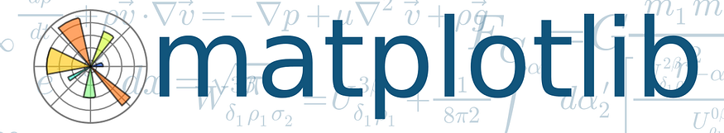
Model makers
Tools : Python
Platform : Jupyter notebook
Libraries used : Pandas, Sk-learn, Matplot, Seaborn

Slide 7
Data description
Source: www.kaggle.com
datetime | Date in dd-mm-yyyy format.
temp | Temperature in degrees Celsius.
dew | Dewpoint temperature in degrees Celsius.
humidity | Humidity in percentage.
sealevelpressure | Pressure in hPa(Hectopascal).
winddir | Wind direction in degrees.
solarradiation | Solar ir radiance in W/m^2.
windspeed | Windspeed in km/hour.
precipprob | probability of rain*100.
preciptype | binary categories of whether it rained on a particular day.
Here our target variable is preciptype which basically determines whether or not it rains on a certain day.

Slide 8
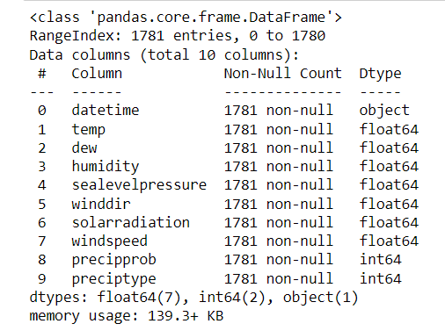
Data Information
There are 10 columns and 1781 rows with data types object, float and integer.
Here, our dependent variable(y) is Preciptype.

Slide 9
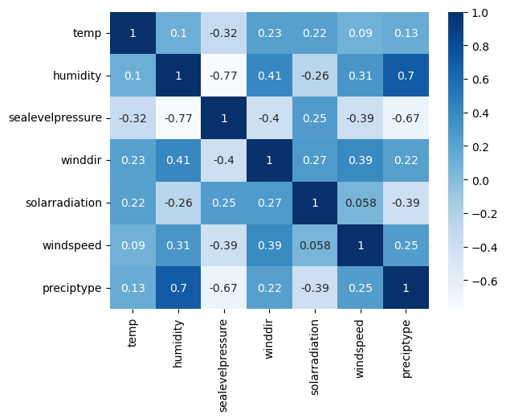
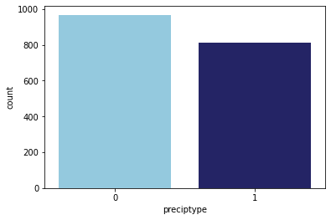
EDA
Checking for dependencies among variables using the correlation matrix
Checking if the categories of the dependent variable are balanced.
Note that dew point temperature is dropped from the data frame as humidity and dew point are linearly related which causes a high linear dependency between them.
The categories of the target variable are approximately equal which is an essential assumption for the logistic regression model.

Slide 10
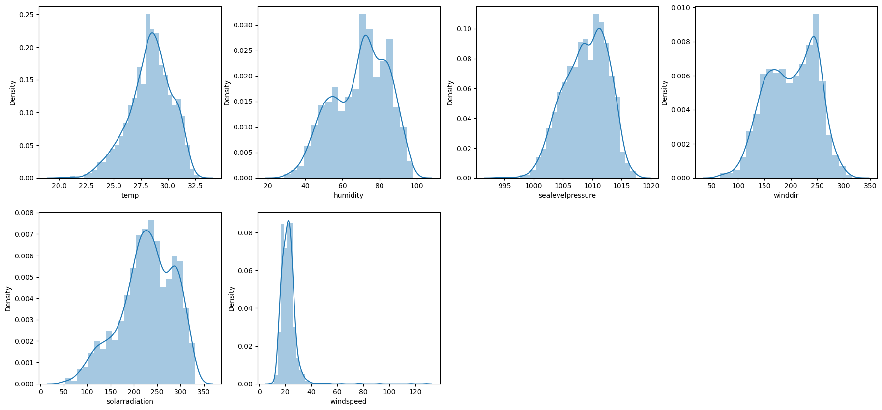
Plotting distributions of each variable
We observe that almost all independent variables follow a normal distribution i.e normality. So, we can go for the logistic regression .

Slide 11
Model building:
Algorithms performed
Logistic regression
K-NN
Random Forest

Slide 12
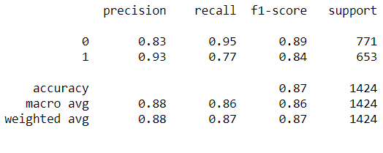
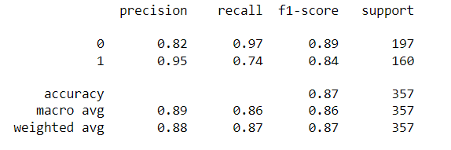
Logistics regression:
Train data confusion matrix
Test data confusion matrix
Specificity: 95%
Sensitivity: 77%
Accuracy: 87%
Specificity: 97%
Sensitivity: 74%
Accuracy: 87%
By performing this algorithm, accuracy is 87%. So, we can say that the model is good fit.

Slide 13
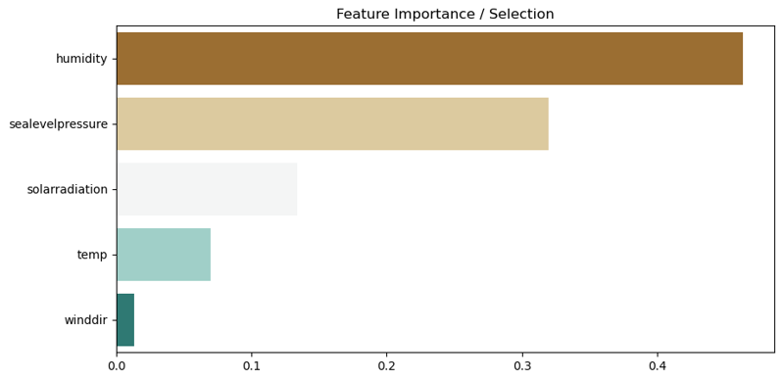
Random Forest:
Top 5 features:-
Humidity
Sea level pressure
Solar radiation
Temperature
Wind direction

Slide 14
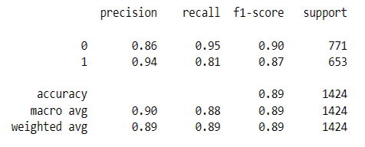
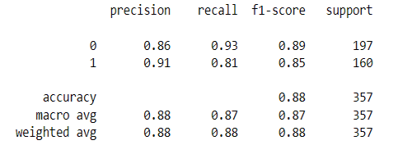
Random Forest Classifier
Confusion Matrix of train data.
Confusion Matrix of test data.
Specificity: 95%
Sensitivity: 81%
Accuracy: 89%
Specificity: 93%
Sensitivity: 81%
Accuracy: 88%
Model is Good Fit.

Slide 15
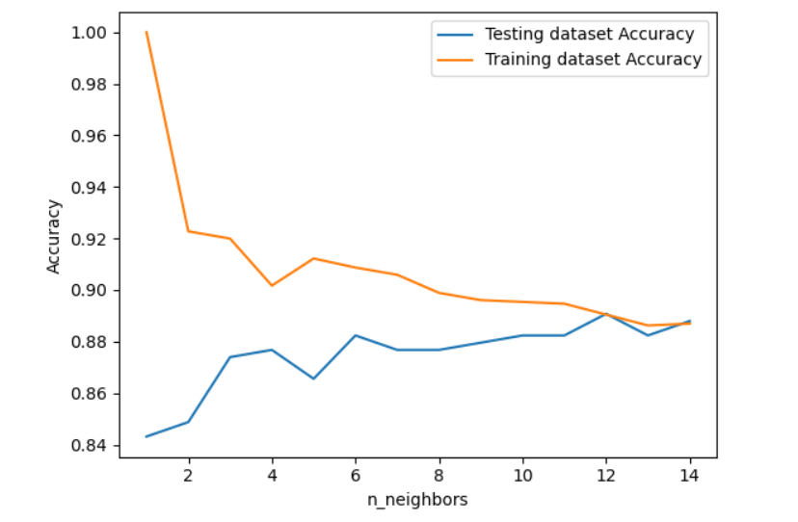
KNN (K- Nearest Neighbors):
The Training and testing dataset showing almost equal accuracy.
Thus, we can say that model is good fit.

Slide 16
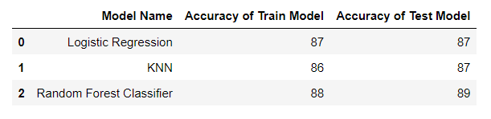
Model performance
Based on the analysis of accuracy, model complexity, interpretability, generalization, and feature importance, random forest model appear to be the most promising for predicting rainfall with accuracy of 89%. However, ongoing monitoring and refinement of these models are necessary to ensure their effectiveness in real-world applications.

Slide 17
Conclusion
In our analysis of Mumbai rainfall forecasting, we applied three models: Logistics Regression, K-NN, and Random Forest. While Logistics Regression showed a prediction accuracy of 87%, K-NN showed prediction accuracy of 87% and Random Forest outperformed it with an accuracy of 89%. These results highlight the effectiveness of machine learning techniques, particularly ensemble methods like Random Forest, in accurately predicting rainfall patterns in Mumbai. Moving forward, leveraging these models can significantly enhance our ability to anticipate and mitigate the impact of rainfall events on the city's infrastructure, agriculture, and public safety.

Slide 18
Thank you……

